Slide 1
Android App
深度学习工坊07

Slide 2
Agenda
Review
SVHN
Tensorflow Development Practice

Slide 3
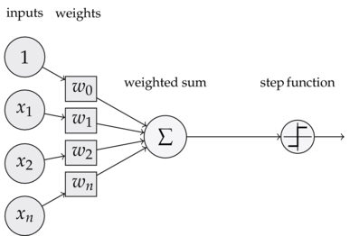
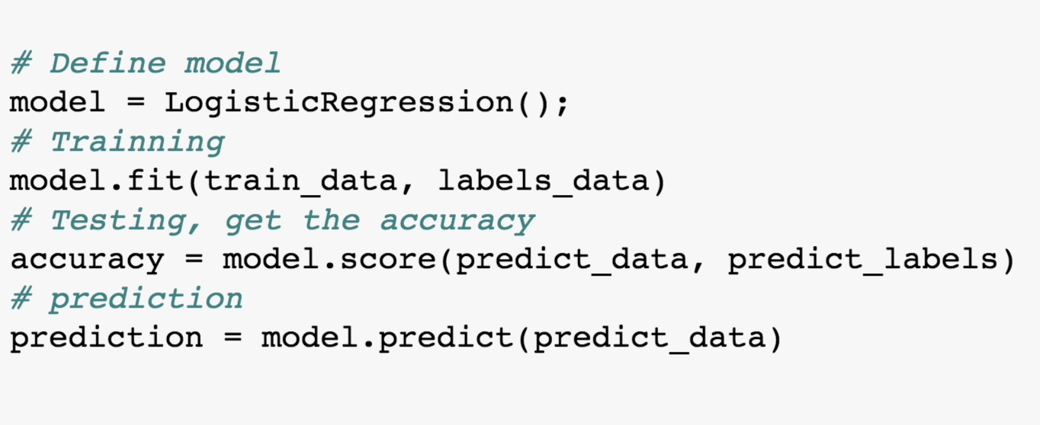
Logistic Regression

Slide 4
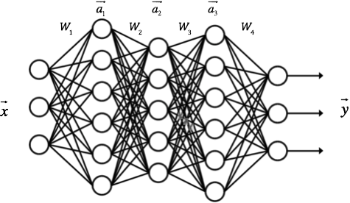
DNN

Slide 5
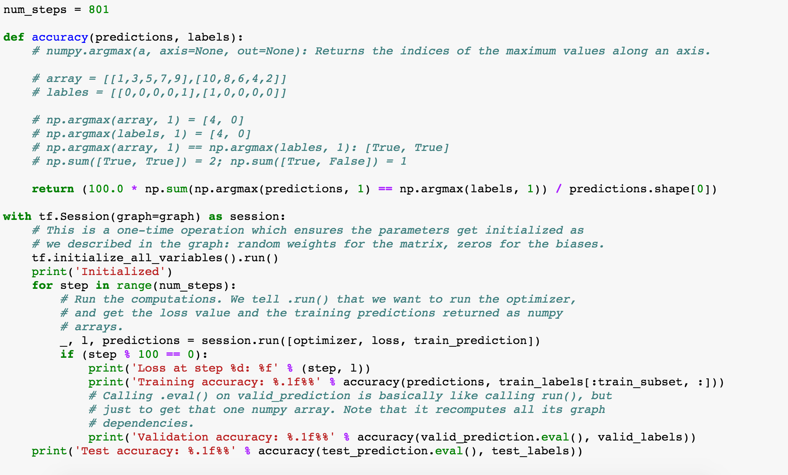
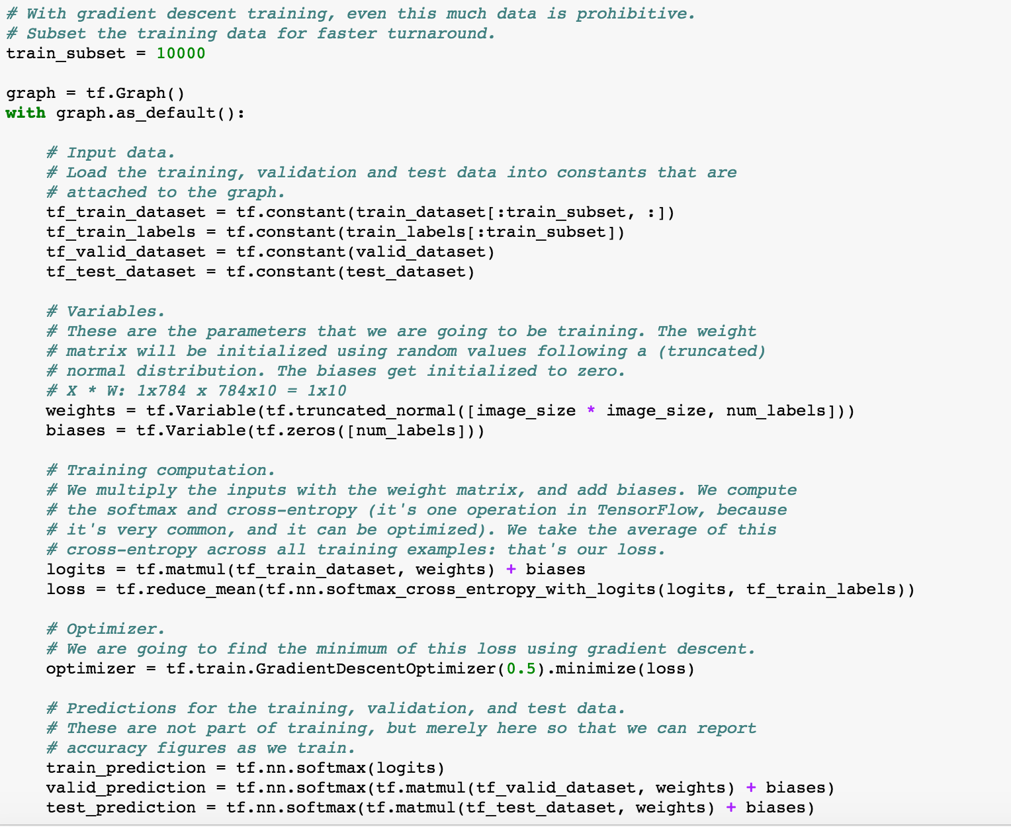
DNN

Slide 6
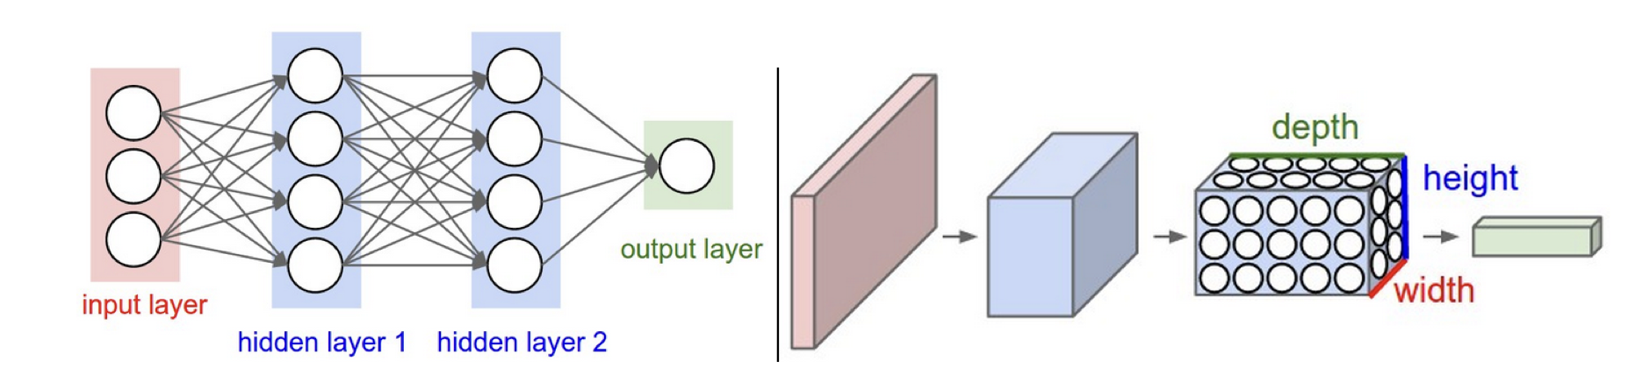

CNN

Slide 7
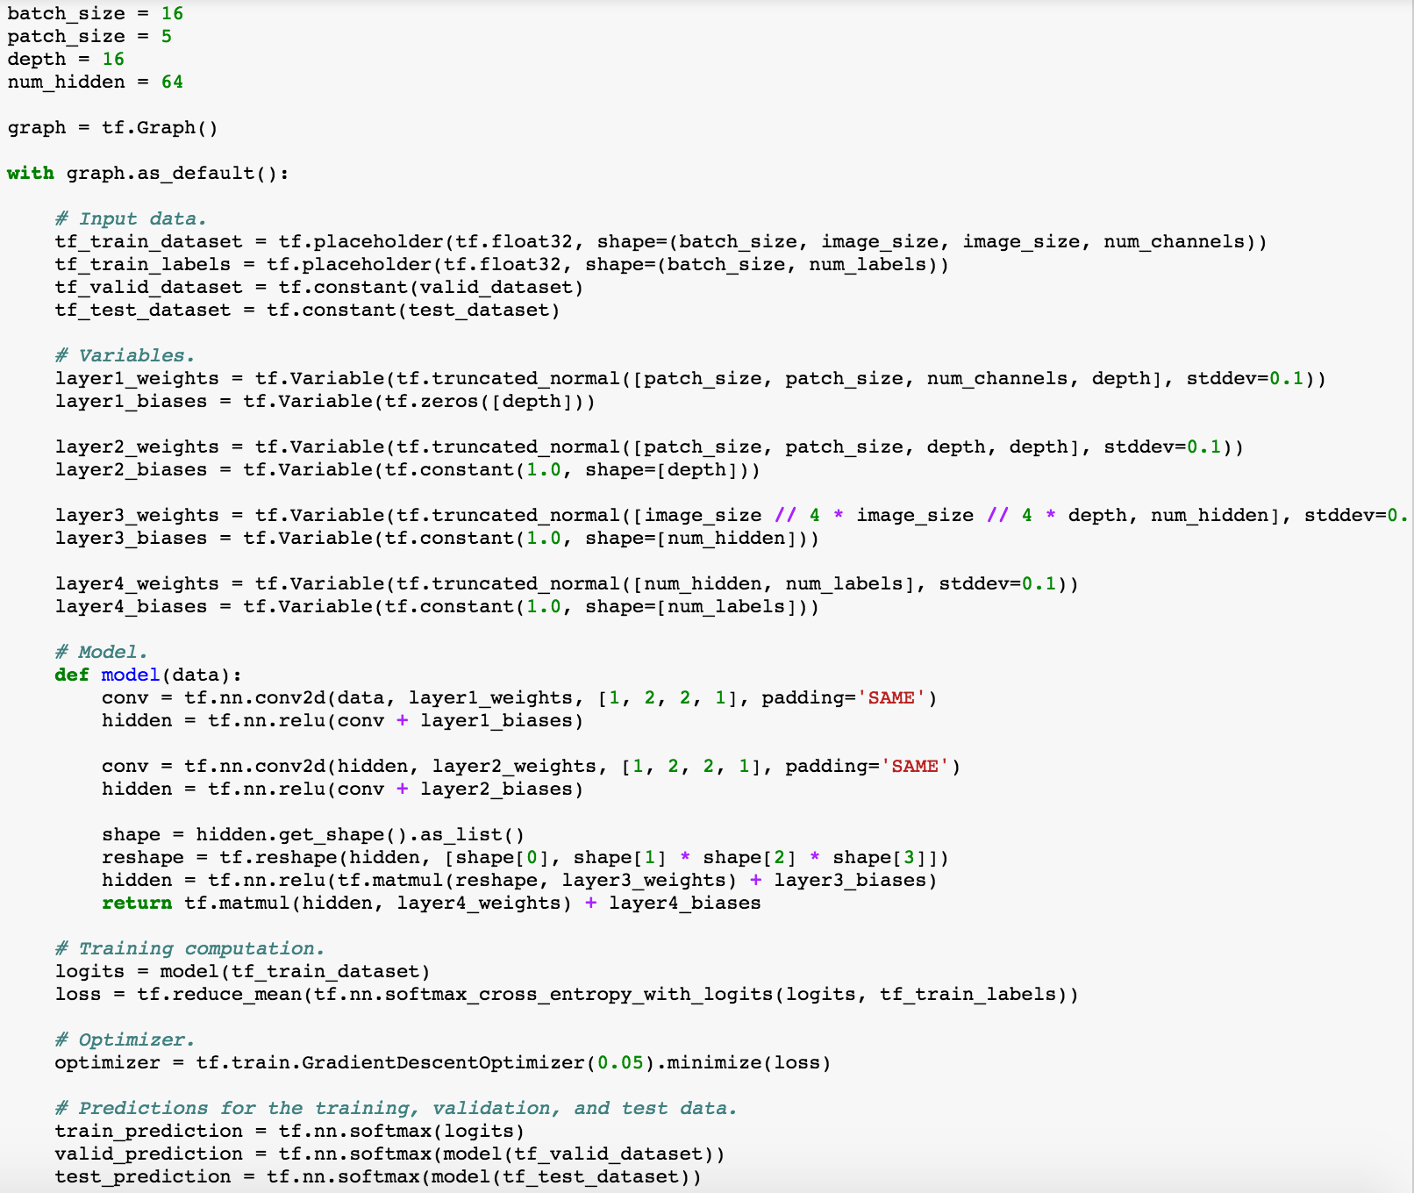
CNN

Slide 8
pattern
I’m a black box
Train Data
Test Data
Train Label
Prediction
Test Label
Accuracy

Slide 9
pattern
Train Data
Train Data
Train Label
I’m a black box
Model
Output
Train Label
Compare
Update
Loss
Optimize

Slide 10
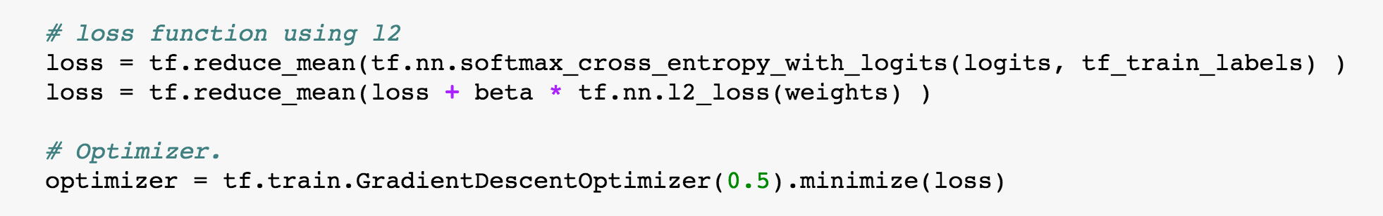
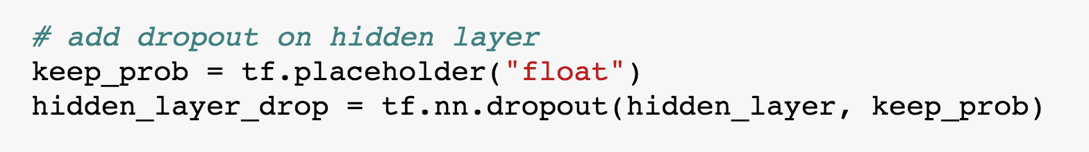
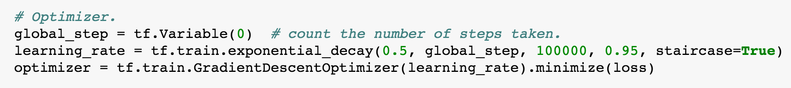
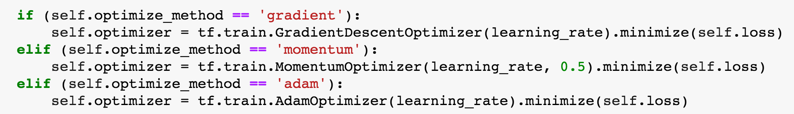
Optimize method
Normalize
Balanced
Randomize

Slide 11
The Street View House Numbers datasets

Slide 12
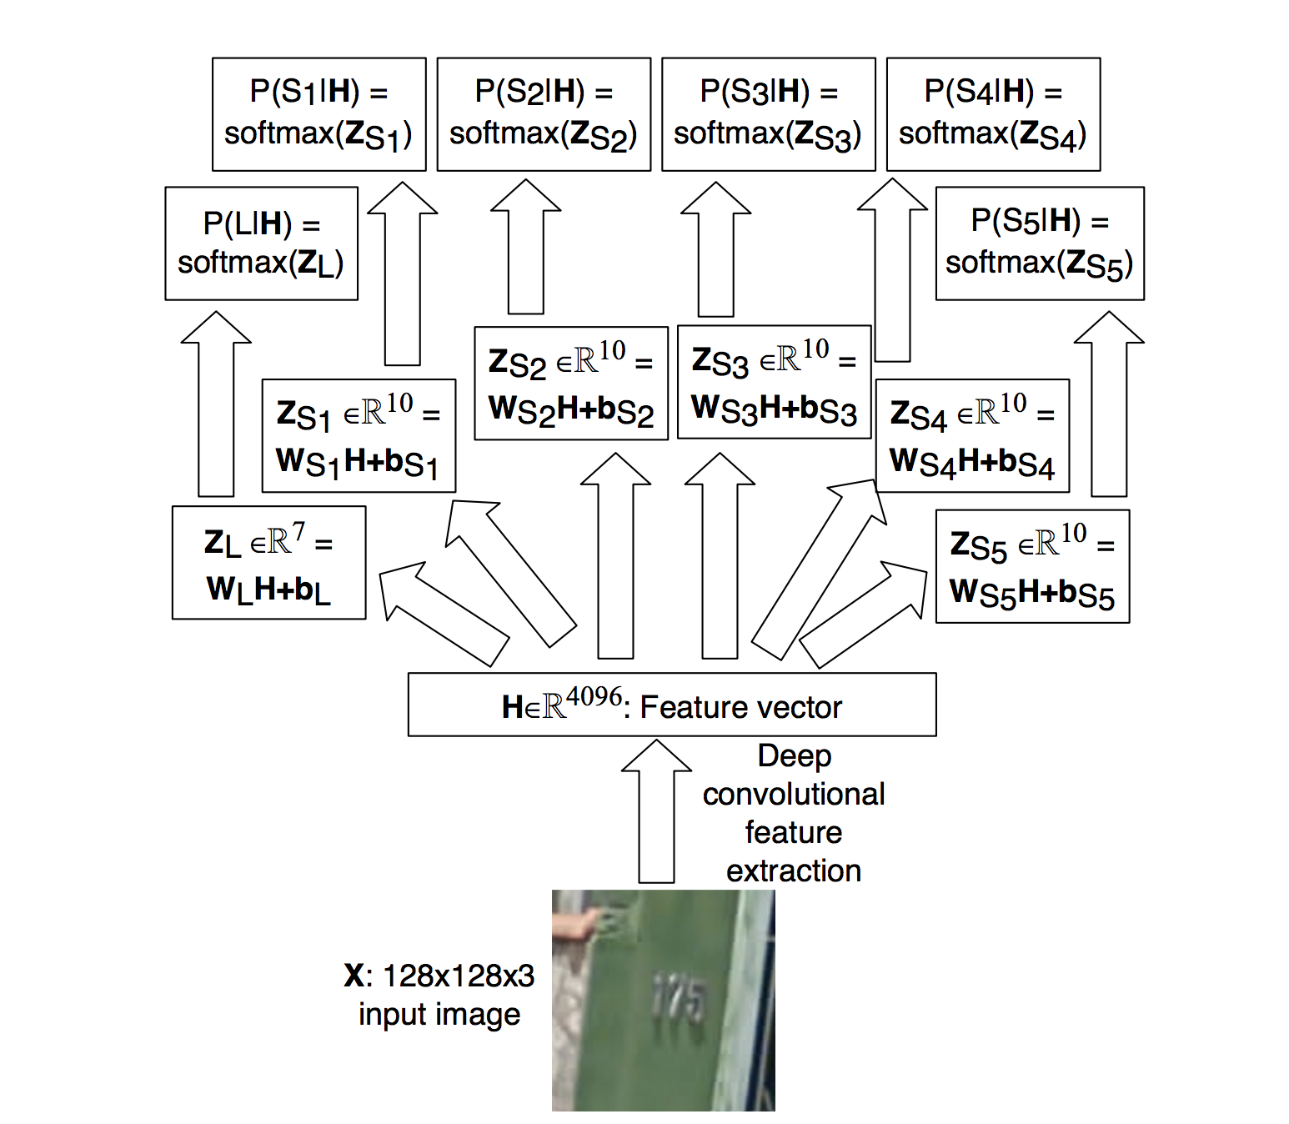
The Street View House Numbers datasets

Slide 13
THANK YOU
Please give me feedbacks

